Slide 1
Introduction to Data Mining

Slide 2
BOOKS
Han, Jiawei, Jian Pei, and Micheline Kamber. Data mining: concepts and techniques. Elsevier, 2011
Tan, Pang-Ning, Michael Steinbach, and Vipin Kumar. ". Introduction to data mining." (2006).

Slide 3


Slide 4
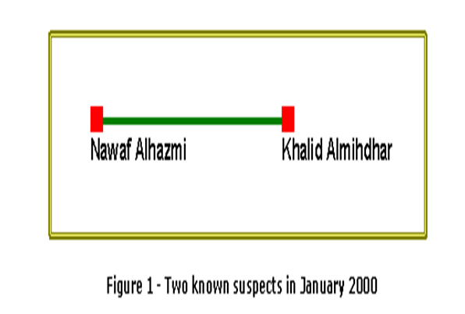

Slide 5
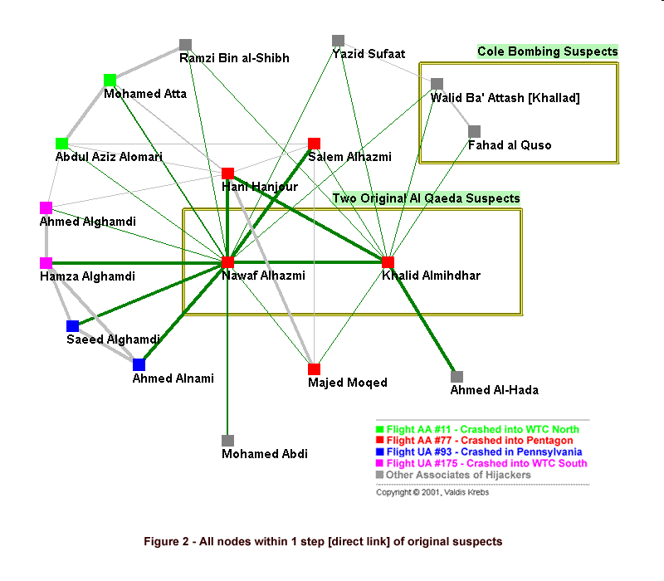

Slide 6
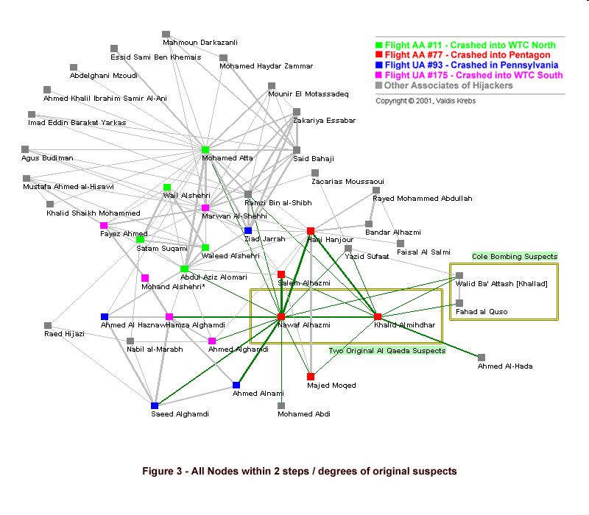

Slide 7
Analysing consumer data
All 19 hijackers were within 2 steps of the two original suspects uncovered in 2000!
One possessed 30 credits cards with a combined balance totaling $250000 and had been in the country for less than two years
Ring leader Mohammed Atta had 12 different addresses, 2 real homes and 10 safe houses

Slide 8
Able Danger
According to Army reserve Lieutenant-Colonel Anthony Shaffer, a top secret Pentagon project code-named Able Danger had identified Atta and three other 9/11 hijackers as members of an al-Qaida cell more than a year before the attacks.
Able Danger was an 18-month highly classified operation tasked, according to Shaffer, with “developing targeting information for al-Qaida on a global scale”, and used data-mining techniques to look for “patterns, associations, and linkages”.

Slide 9
Link analysis
One subject-based data mining technique gaining traction among government practitioners and academics is called link analysis.
Link analysis uses data to make connections between seemingly unconnected people or events. If you know someone is a terrorist, you can use link analysis software to uncover other people with whom the suspect may be interacting.
Many experts believe that the NSA project analyzing millions of domestic phone records is this kind of link analysis system

Slide 10
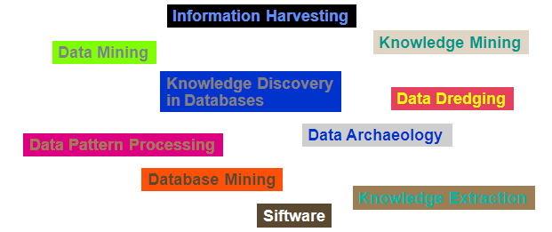
Definition
Data mining is the exploration and analysis of large
quantities of data in order to discover valid, novel,
potentially useful, and ultimately understandable
patterns in data.

Slide 11
By the end of 2020, 44 zettabytes will make up the entire digital universe.

Slide 12
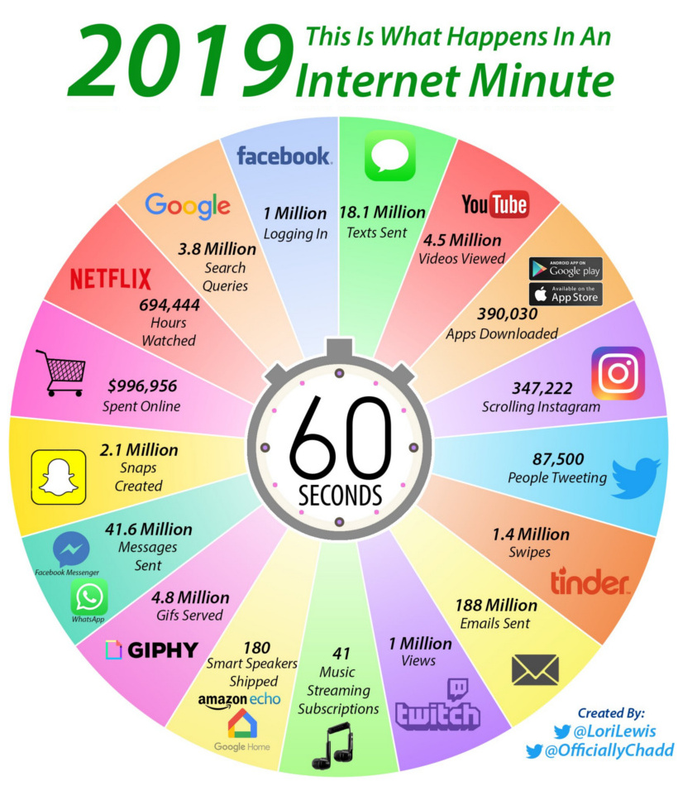

Slide 13
2020
1.7MB of data is created every second by every person during 2020.
In the last two years alone, the astonishing 90% of the world’s data has been created.
2.5 quintillion bytes of data are produced by humans every day.
463 exabytes of data will be generated each day by humans as of 2025.
95 million photos and videos are shared every day on Instagram.
Every day, 306.4 billion emails are sent, and 5 million Tweets are made.

Slide 14
Definition (Cont.)
Data mining is the exploration and analysis of large quantities of data in order to discover valid, novel, potentially useful, and ultimately understandable patterns in data.
Valid: The patterns hold in general.
Novel: We did not know the pattern beforehand.
Useful: We can devise actions from the patterns.
Understandable: We can interpret and comprehend the patterns.

Slide 15
Data Mining
Look for hidden patterns and trends in data that is not immediately apparent from summarizing the data
…. an “Interestingness criteria”

Slide 16
Data Mining
+
=
Interestingness
criteria
Hidden
patterns
Data

Slide 17
Data Mining
Type of data
Type of
Interestingness criteria
+
=
Interestingness
criteria
Hidden
patterns
Data

Slide 18
Type of Data
Tabular (Ex: Transaction data)
Relational
Multi-dimensional
Spatial (Ex: Remote sensing data)
Temporal (Ex: Log information)
Streaming (Ex: multimedia, network traffic)
Spatio-temporal (Ex: GIS)
Tree (Ex: XML data)
Graphs (Ex: WWW, BioMolecular data)
Sequence (Ex: DNA, activity logs)
Text, Multimedia …

Slide 19
Type of Interestingness
Frequency
Rarity
Correlation
Length of occurrence (for sequence and temporal data)
Consistency
Repeating / periodicity
“Abnormal” behavior
Other patterns of interestingness…

Slide 20

Why Use Data Mining Today?
We are drowning in the deluge of data that are being collected world-wide, while starving for knowledge at the same time*
Human analysis skills are inadequate:
Volume and dimensionality of the data
High data growth rate
“Mining needle in a haystack. So much hay and so little time”
* - J. Naisbitt, Megatrends: Ten New Directions Transforming Our Lives. New York: Warner Books, 1982.

Slide 21
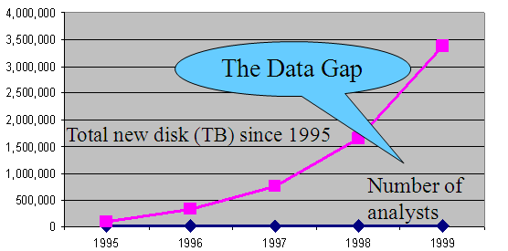
Why Use Data Mining Today?
Moore’s law
- Computer Speed doubles every 18 months
Storage law
total storage doubles every 9 months
Consequence
very little data will ever be looked at by a human
Data Mining is NEEDED to make sense and use of data.
Notes:
Moore's Law states that the number of transistors on a microchip doubles about every two years, though the cost of computers is halved. I

Slide 22
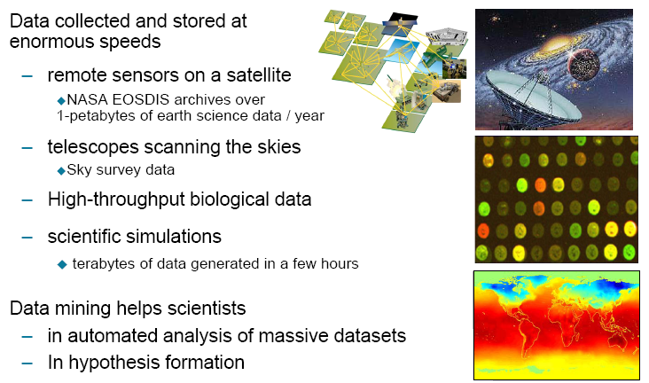
Scientific viewpoint

Slide 23
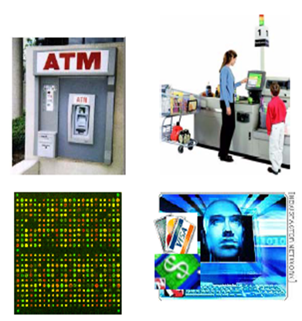
Commercial viewpoint
Web data
Purchases at online stores
Online banking
Notes:
Walmart has 12000 stores in 28 countries. 75% sales online. 304 million active accounts on Amazon

Slide 24
Examples: What is (not) Data Mining?
What is not Data Mining?
Look up phone number in phone directory
Query a Web search engine for information about “Amazon”
What is Data Mining?
Certain names are more prevalent in certain locations
Group together similar documents returned by search engine according to their context (e.g. Amazon rainforest, Amazon.com,)

Slide 25
Database Processing vs. Data Mining Processing
Query
Well defined
SQL
Query
Poorly defined
No precise query language
Data
Operational data
Data
Not operational data
Output
Precise
Subset of database
Output
Fuzzy
Not a subset of database

Slide 26
Query Examples
Database
Data Mining
Find all credit applicants with last name of Smith.
Identify customers who have purchased more than $10,000 in the last month.
Find all customers who have purchased milk
Find all credit applicants who are poor credit risks. (classification)
Identify customers with similar buying habits. (Clustering)
Find all items which are frequently purchased with milk. (association rules)

Slide 27
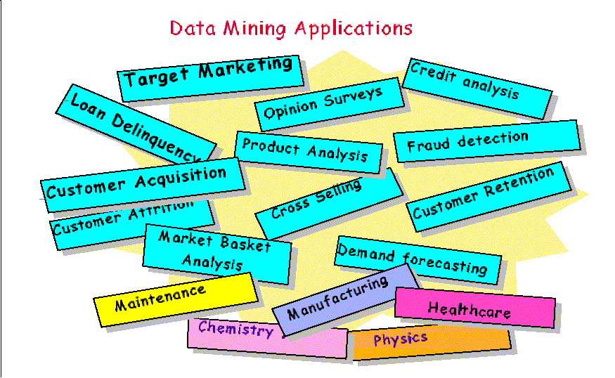

Slide 28
Data Mining Application: Marketing
Sales Analysis
associations between product sales:
beer and diapers
strawberry pop tarts and beer (and hurricanes)
Customer Profiling
data mining can tell you what types of customers buy what products
Identifying Customer Requirements
identify the best products for different customers
use prediction to find what factors will attract new customers

Slide 29
Real Example from the NBA
Play-by-play information recorded by teams
Who is on the court
Who shoots
Results
Coaches want to know what works best
Plays that work well against a given team
Good/bad player matchups
Advanced Scout (from IBM Research) is a data mining tool to answer these questions
Starks+Houston+Ward playing
http://www.nba.com/news_feat/beyond/0126.html

Slide 30
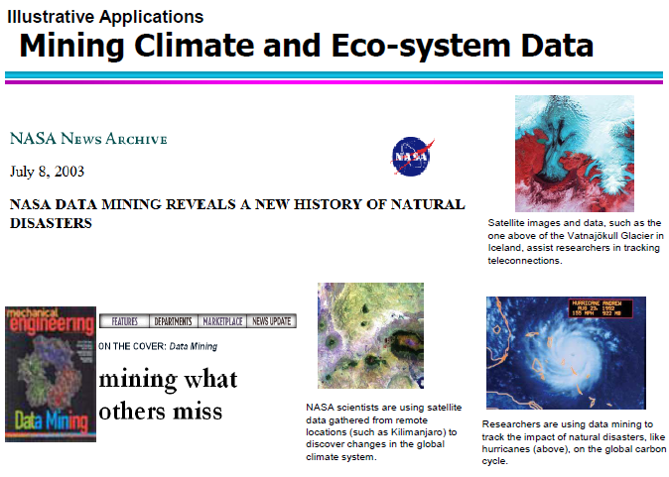

Slide 31
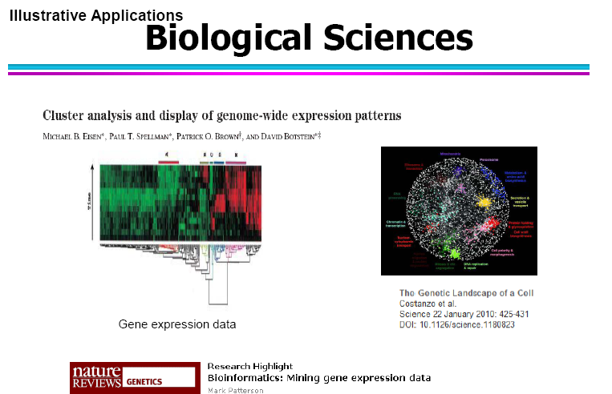

Slide 32
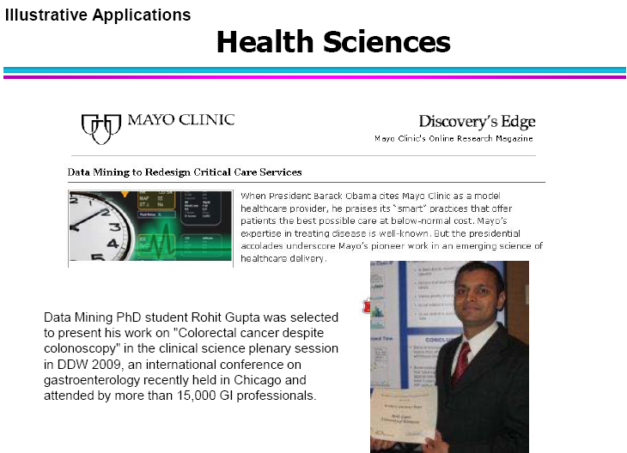

Slide 33
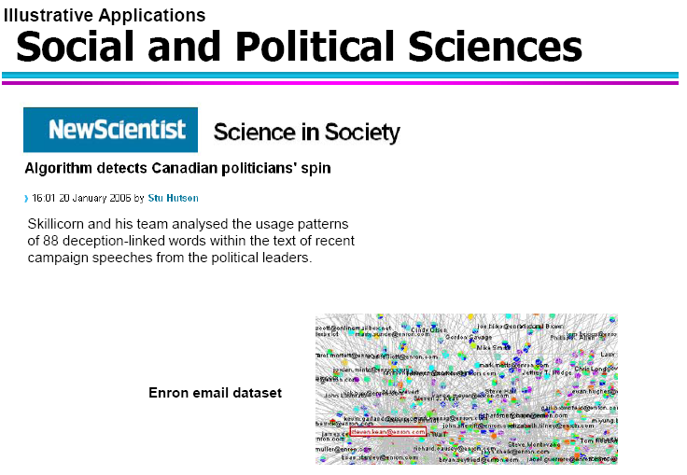
Notes:
Cambridge Analytica, a data mining and analysis firm, was hired by the Trump campaign and played a significant role in Trump’s underdog victory. Cambridge Analytica analyzed the content that a Facebook user liked, shared, or commented on in order to create a psychological profile of that social media user. The Trump campaign and Cambridge Analytica then used these psychological profiles to target persuadable voters.
The Enron Corpus is a database of over 600,000 emails generated by 158 employees^{[1]} of the Enron Corporation in the years leading up to the company's collapse in December 2001. The corpus was generated from Enron email servers by the Federal Energy Regulatory Commission (FERC) during its subsequent investigation.^{[2]} A copy of the email database was subsequently purchased for $10,000 by Andrew McCallum, a computer scientist at the University of Massachusetts Amherst.^{[3]} He released this copy to researchers, providing a trove of data that has been used for studies on social networking and computer-mediated communication.The Enron Scandal surfaced in October 2001 when it was revealed that America's seventh largest company was involved in corporate corruption and accounting fraud. ... ENRON shareholders lost $74 billion leading up to its bankruptcy, and its employees lost their jobs and billions in pension benefits.

Slide 34
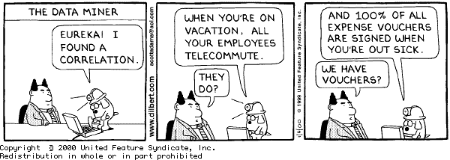
Another Business Reason to use Data Mining

Slide 35
Privacy Concerns
Mining of public and government databases is done, though people have, and continue to raise concerns.
Wiki quote: "data mining gives information that would not be available otherwise. It must be properly interpreted to be useful. When the data collected involves individual people, there are many questions concerning privacy, legality, and ethics."

Slide 36
Bottom Line
Data obtained through Data Mining is incredibly valuable
Companies are understandably reluctant to give up data they have obtained.
Expect to see prevalence of Data Mining and (possibly subversive) methods increase in years to come.

Slide 37
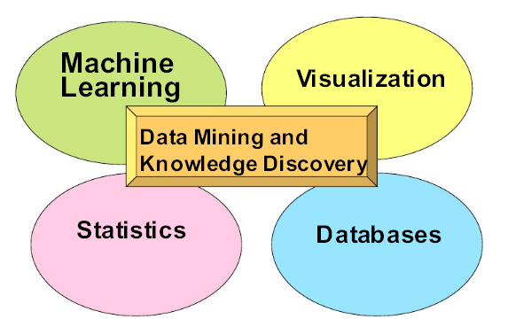
Origins of Data Mining

Slide 38
Data Mining Process
Data preprocessing
Data selection: Identify target datasets and relevant fields
Data cleaning
Remove noise and outliers
Data transformation
Create common units
Generate new fields
Data mining model construction
Model evaluation

Slide 39
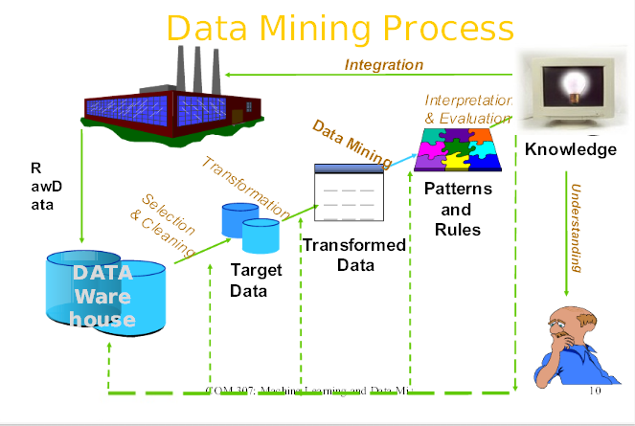

Slide 40
Why Data Warehousing?
Which are our lowest/highest margin customers ?
Who are my customers and what products are they buying?
What is the most effective distribution channel?
What product prom- -otions have the biggest impact on revenue?
Which customers are most likely to go to the competition ?
What impact will new products/services
have on revenue and margins?

Slide 41

Problem: Heterogeneous Information Sources
“Heterogeneities are everywhere”
Personal
Databases
World
Wide
Web
Scientific Databases
Digital Libraries
Different interfaces
Different data representations
Duplicate and inconsistent information

Slide 42
Goal: Unified Access to Data
Integration System
World
Wide
Web
Personal
Databases
Digital Libraries
Scientific Databases
Collects and combines information
Provides integrated view, uniform user interface
Supports sharing

Slide 43
Data Warehouse Architecture
At the top – a centralized database
Generally configured for queries and appends – not transactions
Many indices, materialized views, etc.
Data is loaded and periodically updated via Extract/Transform/Load (ETL) tools
Data Warehouse
ETL pipeline
outputs
ETL
ETL
ETL
ETL
ETL
RDBMS
RDBMS
1
2
HTML
XML
1
1

Slide 44
What is a Data Warehouse? A Practitioners Viewpoint
“A data warehouse is simply a single, complete, and consistent store of data obtained from a variety of sources and made available to end users in a way they can understand and use it in a business context.”
-- Barry Devlin, IBM Consultant

Slide 45
Multi-dimensional Data
Dimensions: Product, Region, Time
Hierarchical summarization paths
Product Region Time
Industry Country Year
Category Region Quarter
Product City Month Week
Office Day
Region
W
S
N
Juice
Product
Cola
Milk
Cream
Toothpaste
Soap
1
2
3
4
5
6
7
Month

Slide 46
Data Mining works with Warehouse Data
Data Warehousing provides the Enterprise with a memory
Data Mining provides the Enterprise with intelligence

Slide 47
Data Mining Tasks
Prediction Tasks
Use some variables to predict unknown or future values of other variables
Description Tasks
Find human-interpretable patterns that describe the data.
Common data mining tasks
Classification [Predictive]
Clustering [Descriptive]
Association Rule Discovery [Descriptive]
Sequential Pattern Discovery [Descriptive]
Regression [Predictive]
Deviation Detection [Predictive]

Slide 48
Classification

Slide 49
Classification: Definition
Given a collection of records (training set )
Each record contains a set of attributes, one of the attributes is the class.
Find a model for class attribute as a function of the values of other attributes.
Goal: previously unseen records should be assigned a class as accurately as possible.
A test set is used to determine the accuracy of the model. Usually, the given data set is divided into training and test sets, with training set used to build the model and test set used to validate it.

Slide 50
An Example (continued)
Classification
So the overall classification process goes like this →
Training Data
Test/Unlabeled Data
Preprocessing, and feature extraction
Preprocessing, and feature extraction
Feature vector
Feature vector
Training
Testing against model/
Classification
Model
Prediction/Evaluation

Slide 51
Issues
Classification
Insufficient training data
Too few features
Too many/irrelevant features
Overfitting / specialization

Slide 52
Classification: Application 1
Direct Marketing
Goal: Reduce cost of mailing by targeting a set of consumers likely to buy a new cell-phone product.
Approach:
Use the data for a similar product introduced before.
We know which customers decided to buy and which decided otherwise. This {buy, don’t buy} decision forms the class attribute.
Collect various demographic, lifestyle, and company-interaction related information about all such customers.
Type of business, where they stay, how much they earn, etc.
Use this information as input attributes to learn a classifier model.

Slide 53
Classification: Application 2
Fraud Detection
Goal: Predict fraudulent cases in credit card transactions.
Approach:
Use credit card transactions and the information on its account-holder as attributes.
When does a customer buy, what does he buy, how often he pays on time, etc
Label past transactions as fraud or fair transactions. This forms the class attribute.
Learn a model for the class of the transactions.
Use this model to detect fraud by observing credit card transactions on an account.

Slide 54
Classification: Application 3
Customer Attrition/Churn:
Goal: To predict whether a customer is likely to be lost to a competitor.
Approach:
Use detailed record of transactions with each of the past and present customers, to find attributes.
How often the customer calls, where he calls, what time-of-the day he calls most, his financial status, marital status, etc.
Label the customers as loyal or disloyal.
Find a model for loyalty.

Slide 55
Classification Techniques
Decision Tree based Methods
Rule-based Methods
Neural Networks
Naïve Bayes
Bayesian Belief Networks
Support Vector Machines

Slide 56
Clustering

Slide 57
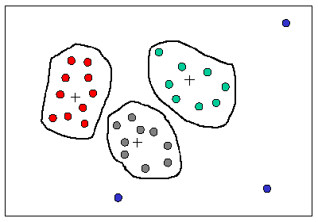
What is Clustering in Data Mining?
Clustering is a process of partitioning a set of data (or objects) in a set of meaningful sub-classes, called clusters
Helps users understand the natural grouping or structure in a data set
Cluster:
a collection of data objects that are “similar” to one another and thus can be treated collectively as one group
but as a collection, they are sufficiently different from other groups
Clustering
unsupervised learning
no predefined classes

Slide 58

Similarity and Dissimilarity Between Objects
Distances are normally used to measure the similarity or dissimilarity between two data objects
Some popular ones include: Minkowski distance:
where i = (x_{i1}, x_{i2}, …, x_{ip}) and j = (x_{j1}, x_{j2}, …, x_{jp}) are two p-dimensional data objects, and q is a positive integer
If q = 1, d is Manhattan distance
If q = 2, d is Euclidean distance:

Slide 59
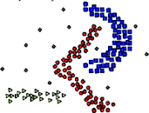





Types of Clustering
Partitional algorithms: Construct various partitions and then evaluate them by some criterion
Hierarchical algorithms: Create a hierarchical decomposition of the set of objects using some criterion
Density based algorithms: based on the idea that a cluster in a data space is a contiguous region of high point density, separated from other such clusters by contiguous regions of low point density
Density
Hierarchical

Slide 60
Hierarchical Clustering
Two main types of hierarchical clustering
Agglomerative: Bottom up
Start with the points as individual clusters
At each step, merge the closest pair of clusters until only one cluster (or k clusters) left
Divisive: Top Down
Start with one, all-inclusive cluster
At each step, split a cluster until each cluster contains a point (or there are k clusters)
Traditional hierarchical algorithms use a similarity or distance matrix
Merge or split one cluster at a time

Slide 61
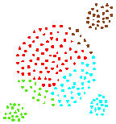
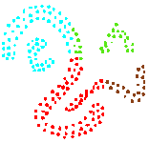
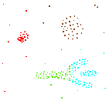
Density-based Approaches
Why Density-Based Clustering methods?
Discover clusters of arbitrary shape.
Clusters – Dense regions of objects separated by regions of low density
DBSCAN – the first density based clustering
OPTICS – density based cluster-ordering
Results of a k-medoid algorithm for k=4

Slide 62
Clustering: Application 1
Market Segmentation:
Goal: subdivide a market into distinct subsets of customers where any subset may conceivably be selected as a market target to be reached with a distinct marketing mix.
Approach:
Collect different attributes of customers based on their geographical and lifestyle related information.
Find clusters of similar customers.
Measure the clustering quality by observing buying patterns of customers in same cluster vs. those from different clusters.

Slide 63
Clustering: Application 2
Document Clustering:
Goal: To find groups of documents that are similar to each other based on the important terms appearing in them.
Approach: To identify frequently occurring terms in each document. Form a similarity measure based on the frequencies of different terms. Use it to cluster.
Gain: Information Retrieval can utilize the clusters to relate a new document or search term to clustered documents.

Slide 64
Introduction
What is association mining?
Searches for relationships between items in a dataset
Also known as market basket analysis (MBA)
Give rule form results
If a customers buys shoes, then 10% of the time he also buys socks
60% of all shoppers will buy bread when they also purchase a packet of milk

Slide 65
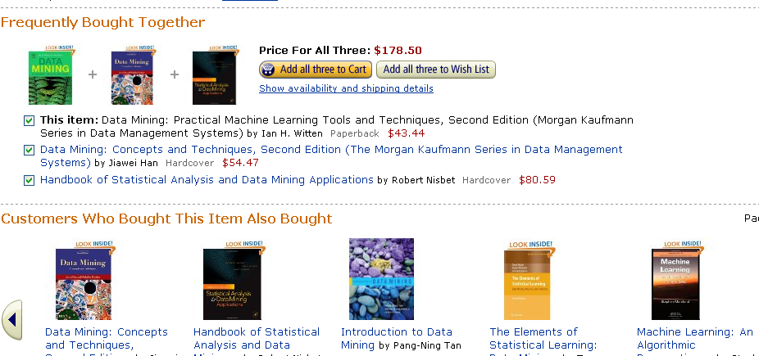

Slide 66
Applications
Items purchased on a credit card, give insight into the next product that customers are likely to purchase
Optional services purchases by telecommunications customers help determine how to bundle these services together to maximize revenue
Banking services used by customers identify customers likely to want other services
Unusual combinations of insurance claims can be a sign of fraud and can spark further investigation
Medical patient histories can give indications of complications based on certain combinations of treatments

Slide 67
The Market-Basket Model
A large set of items, e.g., things sold in a supermarket.
A large set of baskets, each of which is a small set of the items
“Market Baskets” is an abstraction that models any many-many relationship between two concepts: “items” and “baskets.”
Items need not be “contained” in baskets.
Notes:
e.g., the things one customer buys on one day.

Slide 68
Market Basket Analysis
Consider shopping cart filled with several items
Market basket analysis tries to answer the following questions:
Who makes purchases?
What do customers buy together?
In what order do customers purchase items?

Slide 69
Market Basket Analysis
Given:
A database of customer transactions
Each transaction is a set of items
Example: Transaction with TID 111 contains items {Pen, Ink, Milk, Juice}

Slide 70
Market Basket Analysis (Contd.)
Association rules
60% of all customers who purchase X and Y also buy Z.
Sequential patterns
60% of customers who first buy X also purchase Y within three weeks.

Slide 71
Applications
Real market baskets: chain stores keep terabytes of information about what customers buy together.
Tells how typical customers navigate stores, lets them position tempting items.
Suggests tie-in “tricks,” e.g., run sale on diapers and raise the price of beer.

Slide 72
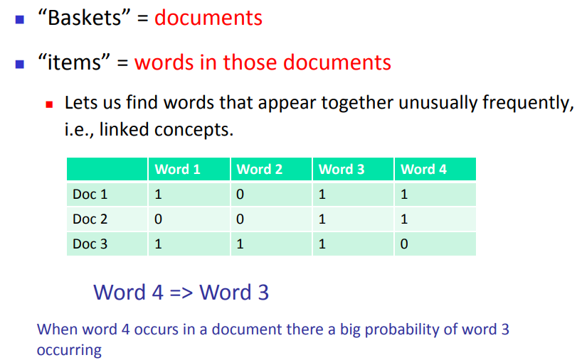

Slide 73
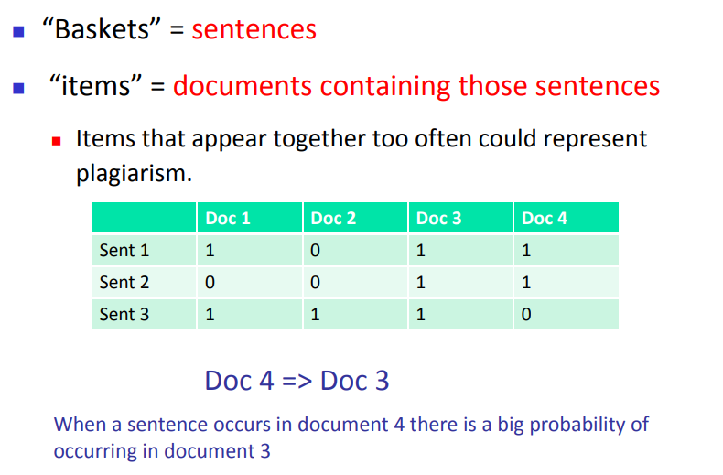

Slide 74
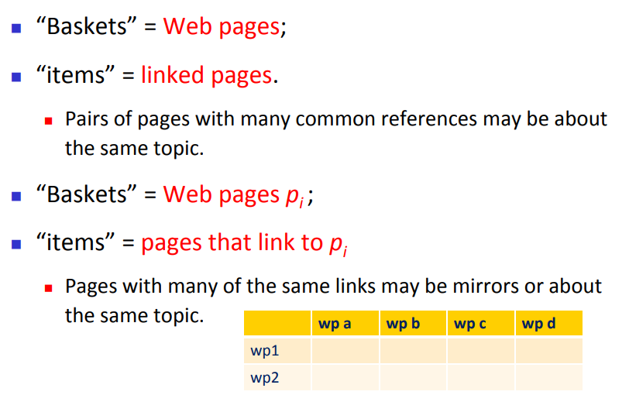

Slide 75
Scale of Problem
A typical supercenter of Walmart sells approximately 120,000 items, compared to the 35 million products sold in Walmart's online store.
The Web has billions of pages.

Slide 76
Association Analysis Techniques
Apriori Algorithm
FP tree growth
Vertical Data format

Slide 77
Anomaly Detection

Slide 78
Anomaly/Outlier Detection
What are anomalies/outliers?
The set of data points that are considerably different than the remainder of the data
Outliers are different from the noise data
Noise is random error or variance in a measured variable
Noise should be removed before outlier detection
Applications:
Credit card fraud detection, telecommunication fraud detection, network intrusion detection, fault detection

Slide 79
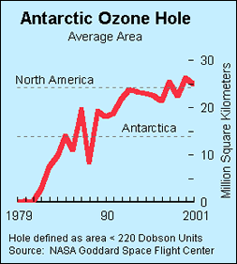
Importance of Anomaly Detection
Ozone Depletion History
In 1985 three researchers (Farman, Gardinar and Shanklin) were puzzled by data gathered by the British Antarctic Survey showing that ozone levels for Antarctica had dropped 10% below normal levels
Why did the Nimbus 7 satellite, which had instruments aboard for recording ozone levels, not record similarly low ozone concentrations?
The ozone concentrations recorded by the satellite were so low they were being treated as outliers by a computer program and discarded!
Sources: http://exploringdata.cqu.edu.au/ozone.html http://www.epa.gov/ozone/science/hole/size.html

Slide 80
Anomaly Detection
Challenges
How many outliers are there in the data?
Method is unsupervised
Validation can be quite challenging (just like for clustering)
Finding needle in a haystack
Working assumption:
There are considerably more “normal” observations than “abnormal” observations (outliers/anomalies) in the data

Slide 81
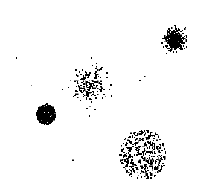
Anomaly Detection Schemes
General Steps
Build a profile of the “normal” behavior
Profile can be patterns or summary statistics for the overall population
Use the “normal” profile to detect anomalies
Anomalies are observations whose characteristics differ significantly from the normal profile
Types of outliers
Global outlier (or point anomaly)
Contextual outlier (or conditional outlier)
Collective Outliers
Notes:
If a collection of data points is anomalous with respect to the entire data set, it is termed as a collective outlier.

Slide 82
Applications of Anomaly Detection
Network intrusion detection
Insurance / Credit card fraud detection
Healthcare Informatics / Medical diagnostics
Industrial Damage Detection
Image Processing / Video surveillance
Novel Topic Detection in Text Mining
…
Notes:
The classic case of automatic outlier rejection becoming automatic information rejection was the South Pole ozone depletion problem. Ozone depletion over the South Pole would have been detected years earlier except for the fact that the satellite data recording the low ozone readings had outlier-rejection code that automatically screened out the "outliers" (that is, the low ozone readings) before the analysis was conducted. Such inadvertent (and incorrect) purging went on for years. It was not until ground-based South Pole readings started detecting low ozone readings that someone decided to double-check as to why the satellite had not picked up this fact--it had, but it had gotten thrown out!

Slide 83
Open source tools
R (http://www.r-project.org)
Tanagra (http://eric.univ-lyon2.fr/~ricco/tanagra/
Weka (Waikato Environment for Knowledge Analysis, http://www.cs.waikato.ac.nz/ml/weka/)
YALE (Yet Another Learning Environment, http://rapid-i.com)
KNIME(Konstanz Information Miner, http://www.knime.org)
Orange (http://www.ailab.si/orange)

Slide 84
Conferences and Journals on Data Mining
KDD Conferences
ACM SIGKDD Int. Conf. on Knowledge Discovery in Databases and Data Mining (KDD)
SIAM Data Mining Conf. (SDM)
(IEEE) Int. Conf. on Data Mining (ICDM)
European Conf. on Machine Learning and Principles and practices of Knowledge Discovery and Data Mining (ECML-PKDD)
Pacific-Asia Conf. on Knowledge Discovery and Data Mining (PAKDD)
Int. Conf. on Web Search and Data Mining (WSDM)
Other related conferences
DB conferences: ACM SIGMOD, VLDB, ICDE, EDBT, ICDT, …
Web and IR conferences: WWW, SIGIR, WSDM
ML conferences: ICML, NIPS
PR conferences: CVPR,
Journals
Data Mining and Knowledge Discovery (DAMI or DMKD)
IEEE Trans. On Knowledge and Data Eng. (TKDE)
KDD Explorations
ACM Trans. on KDD

Slide 85
Some success stories
Compaq
Uses Data mining to examine calls made to customer service to find patterns of complaints
CASSIOPEE trouble shooting system
Derives families of faults to diagnose and predict problems for
Boeing 737
Received the European prize for innovative applications
Major US bank: customer attrition prediction
First segment customers based on financial behavior: found 3 segments
Build attrition models for each of the 3 segments
40-50% of attritions were predicted == factor of 18 increase
Amazon.com
Frequently purchased books
Frequently purchased combination of books
Increased sales by 15%

